Slide 1
Novel approaches for
Severe refractory asthma
Dr. Rami M. Adil Al-Hayali
Assistant professor in medicine
Mosul College of Medicine

Slide 2
Difficult asthma
Asthma that is poorly controlled, despite prescription of optimal asthma treatment
Consider:
Poor adherence to treatment
Poor inhaler technique
Alternative diagnosis (?vocal cord dysfunction)
Persistent allergens exposure
Undertreated co-morbidities

Slide 3
Severe refractory asthma
Patients with asthma in whom:
Alternative diagnoses have been excluded
Co-morbidities have been treated
Trigger factors have been removed (if possible)
Compliance with treatment has been checked
But still have:
Poor asthma control, or
frequent (2) severe exacerbations per year
Despite :
The prescription of high-intensity treatment, or
Can only maintain adequate control when taking systemic corticosteroids
Bel et al. Thorax 2011;66:910-7

Slide 4
Severe refractory asthma
Patients with severe refractory asthma represent small subset of asthmatic patients (5-10% of all patients), but:
The greatest burden on health care system
The population most in need for new treatment approaches

Slide 5
Refractory asthma phenotypes
Phenotyping patients with refractory asthma according to the type of inflammatory cells that is usually present in their airways has proven the most useful approach in selecting new treatment options
Approximately 50% of severe asthmatic exacerbations are oesinophilic in nature, whereas many of the remaining are neutrophilic
Turner et al. Thorax 1995;50:1057-61

Slide 6
Treatment approaches
A variety of approaches have been attempted to
improve outcomes in patients with severe refractory asthma. These have included:
Optimizing bronchodilatation
Reducing airway smooth muscle
Reducing airway inflammatory cell number and/or
activity
Use of macrolide antibiotics

Slide 7
Optimizing bronchodilatation
(Adding tiotropium)
Adding tiotropium was equivalent to adding salmeterol, and both were superior to doubling ICS dose for improving lung function and asthma control.
Tiotropium was superior to salmeterol in improving evening PEF and pre-bronchodilator FEV1.
Peters et al. N Engl J Med 2010;363:1715-26

Slide 8
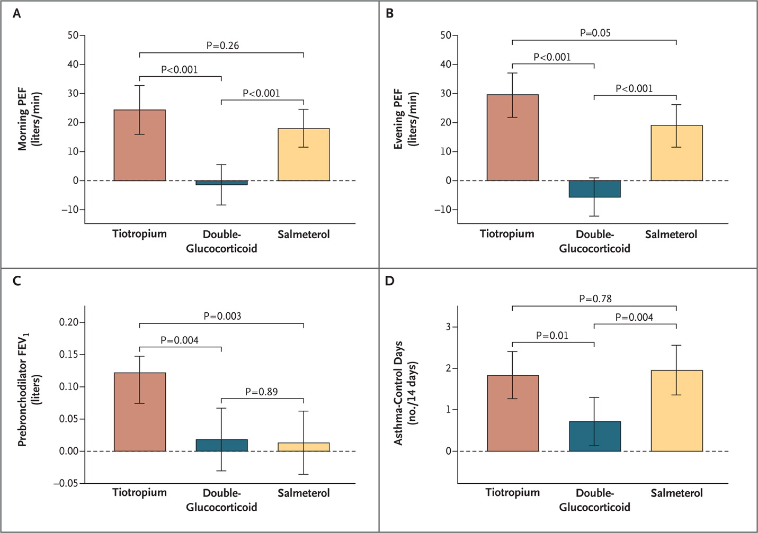

Slide 9
Adding tiotroprium
Another study has evaluated the benefits of adding tiotropium to ICS/LABA treatment in severe refractory asthma, a more clinical relevant situation, as this is the currently recommended treatment approach.
The authors concluded that the addition of tiotropium to high-dose ICS plus LABA significantly improved lung function, as measured by FEV1 over 24 h, in patients with severe refractory asthma.
Kerstjens et al. J Allergy Clin Immunol 2011; 128:308-14

Slide 10
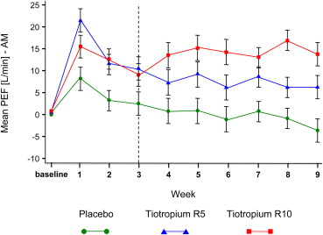

Slide 11
Adding tiotroprium
Unaddressed issues:
Does tiotropium benefit all phenotypes of refractory asthma?
Does it reduce the frequency of exacerbations?

Slide 12
Adding tiotroprium
PrimoTinA-asthma: double-blind parallel-group trial including asthma patients with post-bronchodilator FEV₁<80% predicted while on at least ICS/LABA.
A total of 912 patients were randomized to additional tiotropium Respimat® 5 µg (n=256) or placebo (n=256) for 48 weeks
A pre-planned sub-group analysis of the allergic status was carried out.
Kerstjens et al. N Engl J Med 2012; 367:1198

Slide 13
Adding tiotroprium
Adding tiotropium provided significant lung function improvements at 24 weeks, which were sustained over 48 weeks.
It reduced the risk of any asthma exacerbation by 31% (P<0.0001).
These significant improvements in lung function and reduction in exacerbations were also seen regardless of allergic status

Slide 14
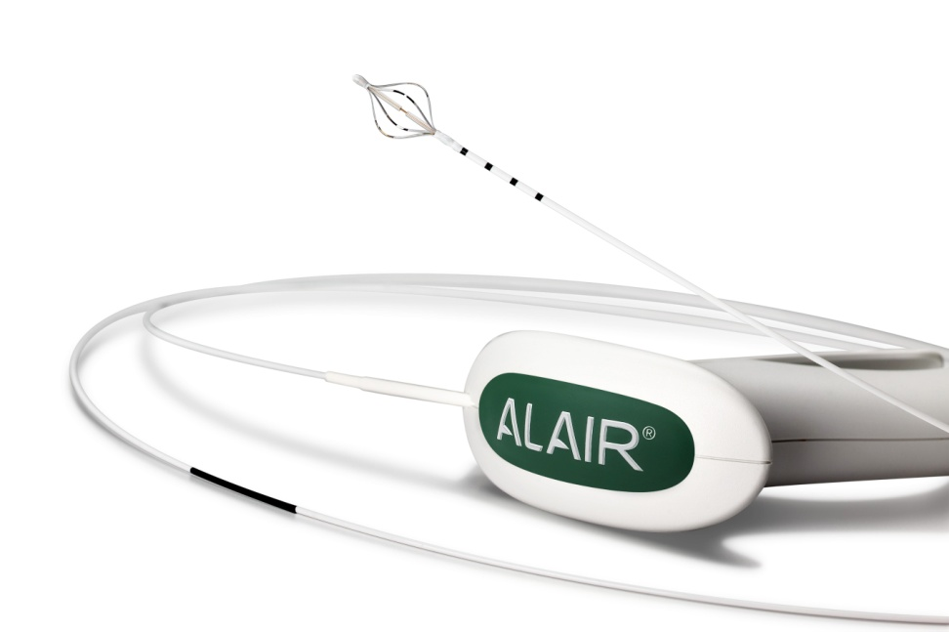
Reducing airway smooth muscle
(bronchial thermoplasty)
Bronchial thermoplasty is a bronchoscopic therapeutic procedure, where the airways are heated using radiofrequency energy to 65°C.
The procedure is done using the Alair radiofrequency catheter passed through the bronchoscope.
Wahidi and Kraft. Am J Respir Crit Care Med 2012; 185:709-14

Slide 15
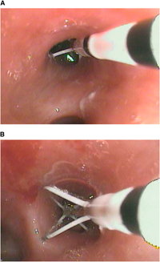
Bronchial thermoplasty
A complete period of treatment requires three bronchoscopies, spaced several weeks apart.
There is convincing evidence that the procedure reduced the volume of airway smooth muscle in the treated airways

Slide 16
Bronchial thermoplasty
The first two of bronchial thermoplasty trials (AIR* and RISA**) enrolled 244 patients total and did not have sham placebo groups as controls.
Patients with severe refractory asthma showing improvement in FEV1 and clinically important improvement in asthma control
*Cox et al. N Engl J Med 2007; 356:1327-37
**Pavord et al. Am J Respir Crit Care Med 2007; 176:1185-1191

Slide 17
Bronchial thermoplasty
A larger study (AIR2), which was the first blinded, sham treatment controlled study, (288 people from 30 centers ) also demonstrated a reduction in severe asthma exacerbations (32%), and a significant improvement in days lost from school or work because of asthma.
Secondary endpoint measures of morning PEF, symptom free days, showed an improvement over baseline in the BT and sham groups, although the differences between the groups were not statistically significant
Castro et al. Am J Respir Crit Care Med 2010; 181:116-24

Slide 18
Safety of bronchial thermoplasty
Some patients have experienced atelectasis and occasionally have required hospitalization following the procedure. These events have all fully been resolved*
The absence of clinical complication and the maintenance of stable lung function (no deterioration of FVC and FEV1) over a 5-year period post-BT support the long-term safety of the procedure.**
*Castro et al. Am J Respir Crit Care Med 2010; 181:116-24
**Thomson et al BMC Pulmonary Medicine 2011; 11:8

Slide 19
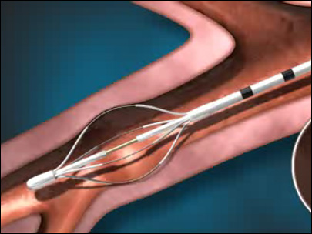
Bronchial thermoplasty
Bronchial thermoplasty has been approved by the FDA in April 27th 2010 as a therapy for severe asthma not controlled by inhaled corticosteroids and long-acting beta agonists

Slide 20
Reducing airway inflammatory cell number and/or activity
(Use of biological agents)
Anti-IgE therapy
Omalizumab
Targeting Th2 response
Anti-IL5 (mepolizumab and reslizumab)
Anti-IL13 (lebrikizumab)
Anti-IL4 (dupilumab)

Slide 21
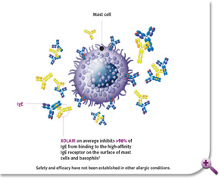
Anti-IgE therapy
(Omalizumab)
Omalizumab is a monoclonal anti-IgE antibody that binds to the Fc region of the IgE molecules, preventing them from binding cell-surface receptors. It is unable to bind to IgE molecules already bound to their receptors (minimizing the risk of inducing anaphylaxis)
Free IgE level soon drop to less than 5% of initial value before omalizumab therapy

Slide 22
Anti-IgE therapy
(Omalizumab)
Two large trials, INNOVATE* (case control) and PERSIST** (comparing the same patients before and after starting therapy) confirmed better asthma control, less use of oral steroids, fewer exacerbations and improved quality of life on using omalizumab in allergic asthma.
*Humbert et al. Allergy2005;60:309-16
**Brucelle et al. Respir Med 2009;103:1633-42

Slide 23
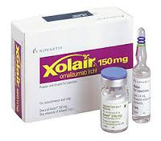
Anti-IgE therapy
(Omalizumab)
On June 22nd 2003, the FDA approved Xolair (omalizumab) for adults and adolescents (12 years of age and above) with moderate to severe persistent asthma who have a positive skin test or in vitro reactivity to a perennial aeroallergen and whose symptoms are inadequately controlled with inhaled corticosteroids.

Slide 24
Anti-IgE therapy
(Omalizumab)
Post-marketing side effects:
Anaphylaxis has been reported in at least 0.2% of cases (compared to less than 0.1% initial incidence during clinical trials), requiring administration in health care setting
Malignant neoplasm: 0.5% risk compared with 0.1% of control population within 1 year follow up
Increased risk of helminthic infections.
Xolair® (omalizumab) for subcutaneous use – Genentech, Inc. July 2010

Slide 25
Anti-IgE therapy
(Omalizumab)
FDA is evaluating interim safety findings from an ongoing study of Xolair (omalizumab) titled Evaluating the Clinical Effectiveness and Long-Term Safety in Patients with Moderate to Severe Asthma (EXCELS) that suggests a disproportionate increase in ischemic heart disease, arrhythmias, cardiomyopathy and cardiac failure, pulmonary hypertension, cerebrovascular disorders, and embolic, thrombotic and thrombophlebitic events in patients treated with Xolair compared to the control group of patients not given the drug

Slide 26
Targeting Th2 response
Th1 and Th2 are subsets of the cells that develop from the same precursor cells and produce different cytokines
Th1 mediate macrophage activation and phagocyte dependant inflammation through production of INFγ (normal airways)
Th2 mediate allergic response resulting in the production of IL-4, IL-5, IL-9 and IL-13 (asthmatic airways)

Slide 27
Targeting Th2 response
IL-4 and IL-13 induce B-cells to produce IgE
IL-13 induce epithelial cells to produce periostin (a biomarker of airway inflammation)
IL-5 promotes the proliferation, differentiation, recruitment and survival of oesinophils
Thus:
Specific pattern of cytokine expression can identify patients who may respond better to targeted therapy

Slide 28
Mepolizumab for severe eosinophilic asthma
Dose Ranging Efficacy And safety with Mepolizumab in severe asthma (DREAM) trial
A multicentre, double-blind, placebo-controlled trial at 81 centres in 13 countries enrolled 621 patients were aged 12–74 years, and had a history of recurrent severe asthma exacerbations, and had signs of eosinophilic inflammation. They were randomly assigned to receive one of three doses of intravenous mepolizumab (75 mg, 250 mg, or 750 mg) or matched placebo (100 mL 0·9% NaCl).
The primary outcome measure was the rate of clinically significant asthma exacerbations over 12 months
Pavord et al. Lancet 2012;380:651-59

Slide 29
Mepolizumab for severe eosinophilic asthma
(DREAM)
The rate of clinically significant exacerbations was reduced by 39%-48% (different doses) compared with placebo
Small effects on FEV1 and QOL scores, which generally did not differ significantly from those reported with placebo
A dissociation between symptoms and risk of exacerbations probably exists in patients with severe asthma.
Pavord et al. Lancet 2012;380:651-59

Slide 30
Anti-interleukin-5 Therapy
(Reslizumab)
In patients with poorly controlled asthma and sputum eosinophilia, administration of the monoclonal antibody to IL-5, reslizumab, resulted in statistically significant yet modest improvement in pulmonary function when compared with placebo after 15 weeks, and failed to improve asthma control in the population as a whole.
In subgroup analyses, the response to therapy seemed to be greater in those with a history of nasal polyposis
The presence of nasal polyps may help identify a subset of patients who may benefit the most from anti–IL-5 therapy, but this will need to be specifically investigated in future studies.
Castro et al. Am J Resp Crit Care Med 2011;148:1125-32

Slide 31
Anti-interleukin-13 therapy
(Lebrikizumab)
A randomized, double-blind, placebo-controlled study of lebrikizumab, a monoclonal antibody to interleukin-13, in 219 adults who had asthma that was inadequately controlled despite inhaled glucocorticoid therapy.
The primary efficacy outcome was the relative change in prebronchodilator (FEV1) from baseline to week 12
Corren et al. N Engl J Med2011;356:1088-98

Slide 32
Anti-interleukin-13 therapy
(Lebrikizumab)
At week 12, the mean increase in FEV1 was 5.5 percentage points higher in the lebrikizumab group than in the placebo group (P = 0.02).
Among patients in the high-periostin subgroup, the increase from baseline FEV1 was 8.2 percentage points higher in the lebrikizumab group than in the placebo group (P = 0.03).
Corren et al. N Engl J Med2011;356:1088-98

Slide 33
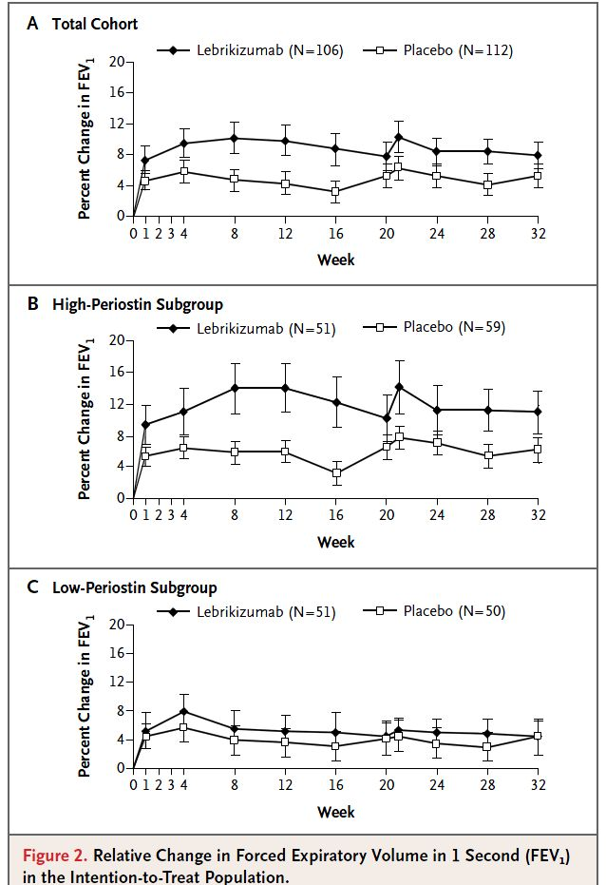

Slide 34
Anti-interleukin-4 therapy
(Dupilumab)
Patients with persistent, moderate-to-severe asthma and a blood eosinophil count of at least 300 cells per microliter or a sputum eosinophil level of at least 3% who used ICS/LABA received dupilumab (fully humanized monoclonal antibody to the α subunit of the IL-4 receptors)or placebo subcutaneously once weekly.
Patients were instructed to discontinue LABAs at week 4 and to taper and discontinue inhaled glucocorticoids during weeks 6 through 9.
Patients received the study drug for 12 weeks or until a protocol-defined asthma exacerbation occurred.
Wenzel et al N Engl J Med 2013;368:2455-66.

Slide 35
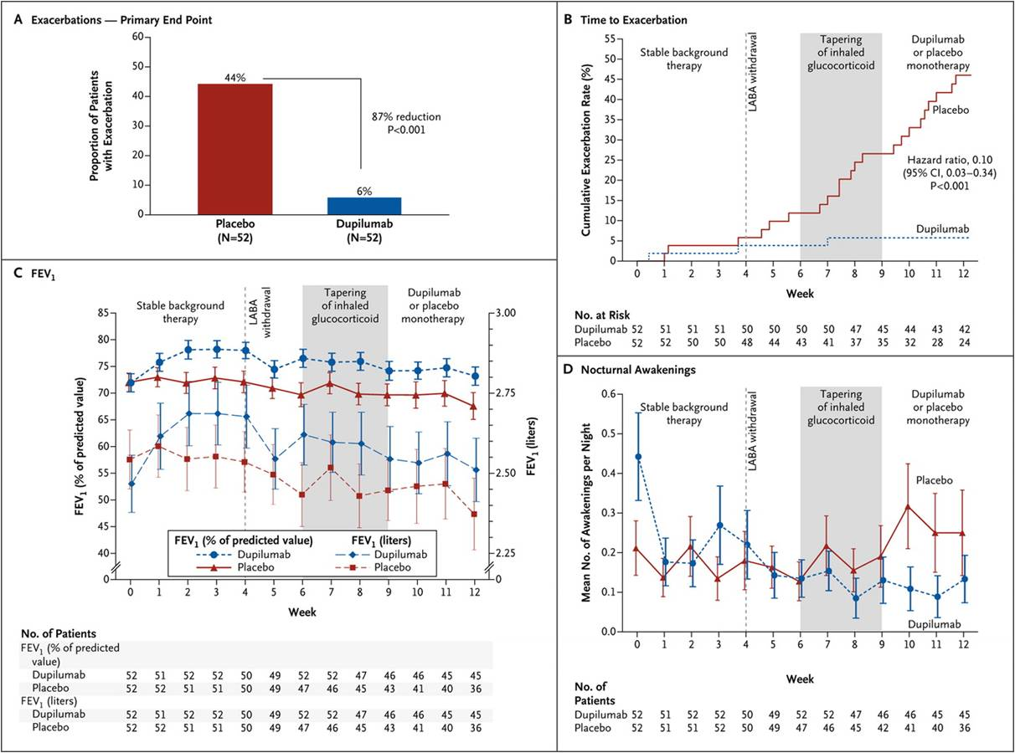

Slide 36
Anti-interleukin-4 therapy
(Dupilumab)
Three patients had an asthma exacerbation with dupilumab (6%) versus 23 with placebo (44%), corresponding to an 87% reduction with dupilumab (P<0.001).
Significant improvements were observed for most measures of lung function and asthma control.
This study, using a withdrawal design, was not designed to show a beneficial adjuvant effect of dupilumab. Rather, it shows that dupilumab is able to substitute ICS and LABAs in a specific subgroup of patients with asthma.
Wenzel et al N Engl J Med 2013;368:2455-66

Slide 37
The role of macrolide prophylaxis
The non-eosinophilic asthma phenotype responds poorly to currently available anti-inflammatory therapy*
Macrolides have immunomodulatory and anti-inflammatory effects in addition to their antibacterial effects. Maintenance treatment with macrolides such as azithromycin has been proved to be effective in chronic neutrophilic airway diseases including cystic fibrosis, bronchiectasis **and recently COPD***
*McGrath et al. Am J Respir Crit Care Med 2012;185:612-9
**Wong et al. Lancet 2012;380:660-7
***Albert et al. N Engl J Med 2011;365:689-98

Slide 38
Azithromycin for prevention of exacerbations in severe asthma (AZISAST)
A randomised double-blind placebo-controlled trial in subjects with severe asthma.
Subjects received low-dose azithromycin (n=55) or placebo (n=54) as add-on treatmen to ICS/LABA for 6 months.
The primary endpoints (PFPs) were the rate of severe exacerbations and LRTI requiring treatment with antibiotics during the 26-week treatment phase
Brussel et al. Thorax 2013;68:322-39

Slide 39
Azithromycin for prevention of exacerbations in severe asthma (AZISAST)
The rate of PEPs during 6 months was not significantly different between the two treatment groups
In a predefined subgroup analysis according to the inflammatory phenotype, azithromycin was associated with a significantly lower PEPs rate than placebo in subjects with noneosinophilic severe asthma (blood eosinophilia ≤200/ml)
Azithromycin significantly improved QOL score but there were no significant differences in the asthma contol or lung function.
Brussel et al. Thorax 2013;68:322-39

Slide 40
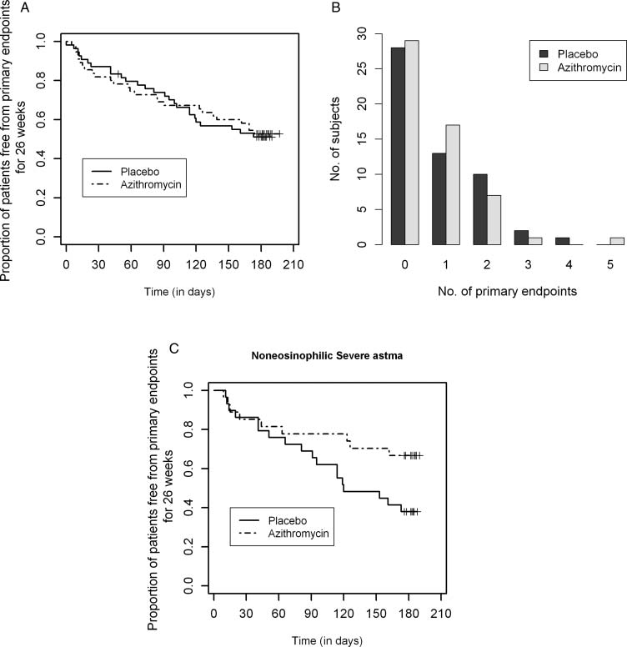

Slide 41
Azithromycin prophylaxis
The beneficial effects of azithromycin in non-eosinophilic severe asthma might be due to antibiotic properties or antiinflammatory and immunomodulatory effects.
Chronic respiratory infection with atypical bacteria such as Mycoplasma pneumoniae or Chlamydophila pneumoniae might play a role in the pathogenesis of severe asthma

