Slide 1

Presentation
prepared by
Mohammed Ibrahim
Programmer
Computer & Internet Center
Mosul University

Slide 2
What is MikroTik RouterOS™ ?
MikroTik RouterOS™ is a router operating system and software which turns a regular Intel PC or MikroTik RouterBOARD™ hardware into a dedicated router.
The MikroTik RouterOS™ is standalone Operating System. The OS is Linux kernel based and very stable.

Slide 3
Licensing Issues
How many MikroTik RouterOS™ installations does one license cover?
The license is per RouterOS installation. Each installed router needs a separate license.
Does the license expire?
The license never expires. The router runs for ever. Your only limitation is to which versions you can upgrade. For example if it says "Upgradable to v4.x", it means you can use all v4 releases, but not v5 This doesn't mean you can't stay on v4.x as long as you want.

Slide 4
Licensing Issues
Can I use my MikroTik RouterOS™ software license on a different hardware?
Yes, you can use different hardware (motherboard, NICs), but you should use the same HDD. The license is kept with the HDD unless format or fdisk utilities are used. It is not required to reinstall the system when moving to different hardware. When paying for the license, please be aware, that it cannot be used on another harddrive than the one it was installed upon.
License transfer to another hard drive costs 10$. Contact support to arrange this
for more support visit www.mikrotik.com

Slide 5
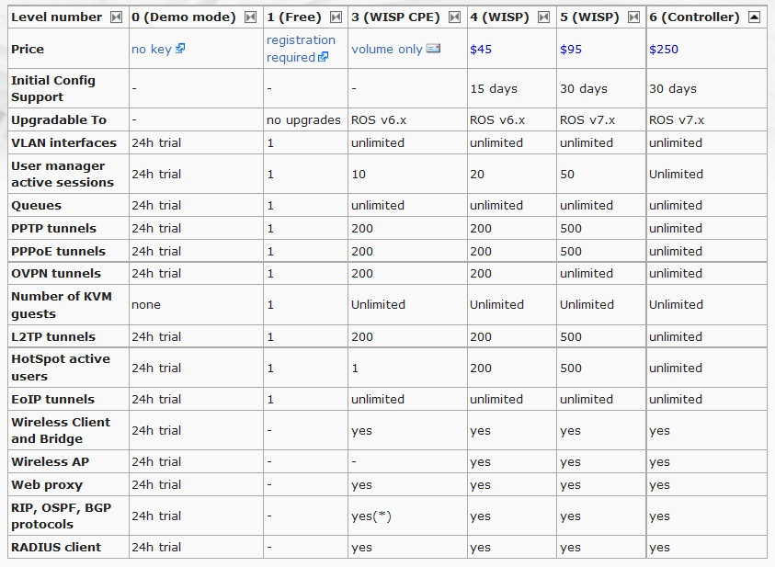

Slide 6
What features does RouterOS™ have?
Firewall
Routing
Forwarding
VPN
DNS
Wireless
Hotspot
Quality of Service
Web Proxy
Tools → Ping, traceroute, Bandwidth test, Telnet, SSH, E-mail, TFTP server, SNMP for providing graphs, statsRADIUS client and server (User Manager), IP Scan, ….

Slide 7
Practical part
Configuration
Introduction
IP Address
Getway
DNS
DHCP
Firewall
Hotspot

Slide 8
Thank you for listening

