Slide 1

Cloud Computing
الحوسبة السحابية

Slide 2
subject
History of Cloud
Before the cloud
Cloud Conditions
Definition of Cloud Computing
Cloud Anatomy
Type of Cloud
Cloud advantages & disadvantages
Examples for use clouds

Slide 3
HISTORY
Concept dating back to the 1960’s by “John McCarthy”, a computer scientist, brought up the idea that “computation may someday be organized as a public utility”. – Wikipedia
Idea that revolutionized Cloud Computing:
- Utility computing
- Grid computing
“In some way, the cloud is a natural next step from the grid-utility model” said Frank Gens, an analyst at the research firm IDS. – Wikipedia

Slide 4
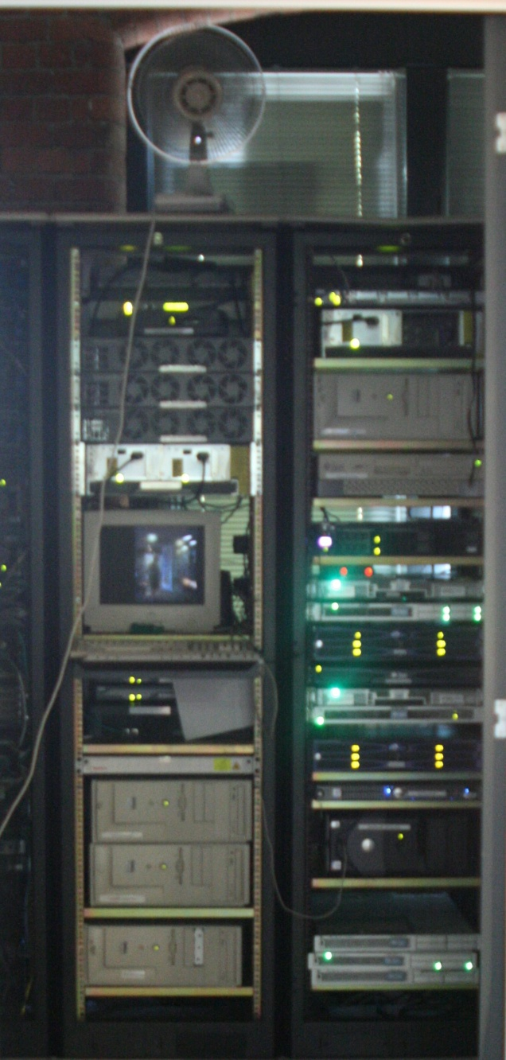
Before the cloud
A server for each service
  - Hardware requirements
  - Software requirements (OS)
  - Security requirements
Problems:
  - Hardware maintenance
  - Electric bills
  - delays

Slide 5
Cloud Conditions
There are few underlying technologies developed in the last years:
- Virtualization
- Distributed Storage
- Web

Slide 6
Virtualization
Virtualized – Multiple applications can run in one computer
App
App
App
App
App
App
Operating System
OS
OS
OS
Hardware
Hypervisor
Hardware
Traditional Stack
Virtualized Stack

Slide 7
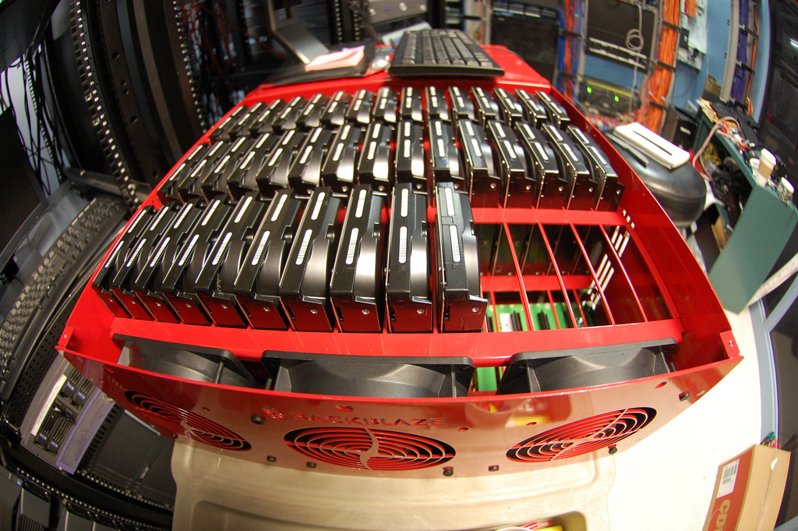

Distributed storage
is any file system that allows access to files stored on multiple hosts and share them via a network.

Slide 8

Web
communication between two parts over the Web (Internet), typically conveyed using HTTP, XML and other Web-related standards.

Slide 9
What is Cloud Computing?
Definition: There is no unique and standard definition out there, One of those definitions:
cloud computing: is a technology depending on transfer the process and storage space for a local computer to the called (Cloud), and this cloud it is a server device reached it from Internet. And this way can convert the Data technology from products to the services.
Basically a cloud is a virtualization of resources that manages and maintains itself. – Wikipedia

Slide 10
Cloud Computing
Cloud Computing is a technology that uses the internet and central remote servers to maintain data and applications. Cloud computing allows consumers and businesses to use applications without installation and access their personal files at any computer with internet access. This technology allows for much more efficient computing by centralizing data storage, processing and bandwidth.

Slide 11
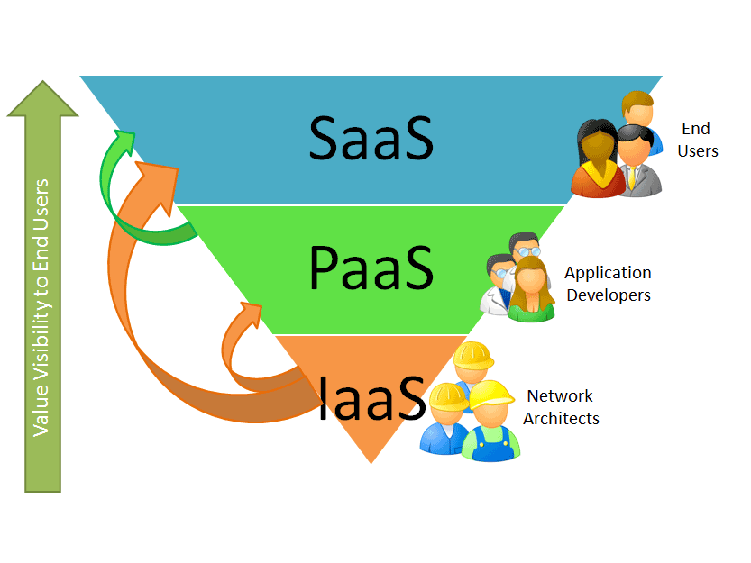
Cloud Anatomy
Broadly classified under the three categories:

Slide 12

Infrastructure as a service (IaaS)
Means used the cloud as the infrastructure with power process, RAM and storage space, and you have all ways to establishes your servers and your applications for it.
Example:

Slide 13

Platform as a Service (PaaS)
Means used the cloud to put your applications on it and you can work for all applications and also put your OS and will there compatibles for all applications.
Example:

Slide 14
Software as a Service (SaaS)
Means you use any application it saved in cloud and your pc it is for connection only.
Example:
1- use Photoshop in cloud to change your picture, and your pc is connection to internet only.
2- YouTube.

Slide 15
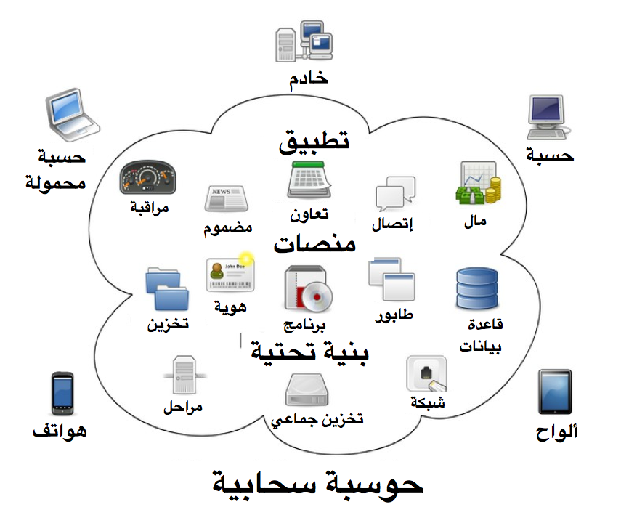

Slide 16
Type of Cloud
Public clouds: the services are delivered to the client via the Internet from a third party service provider.
Example: Amazon
Private clouds: this services are managed and provided within the organization. There are less restriction on network bandwidth, fewer security exposures and other legal requirement compared to the public cloud.
Example: HP Data Centre

Slide 17
Cloud advantages
Pay-per-use, minimum investment , cost efficient
Availability, no worries about hardware faults
Elasticity, scaling up and down in seconds
Everything is manageable from a web interface
Unlimited storage capacity
Improved document format compatibility
Reduced software maintenance

Slide 18
Cloud disadvantages
Requires a constant internet connection
Don’t work well with low speed connection
Can be slow
Data stored might not be secure
Stored data can be lost

Slide 19
There are many services for clouds
Services for Email: Gmail, Yahoo mail, Hotmail
Services for storage clouds: Google Drive, skyDrive
Services for Music clouds: Google Music, Amazon cloud player, iTunes / iCloud
Applications clouds: Google Docs, Photoshop Express
OS cloud: Google Chrome OS, Jolicloud

Slide 20
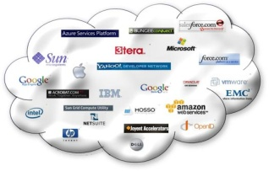

Providers of Cloud computing

Slide 21

References
http://ar.wikipedia.org/wiki/File:Cloud_computing.svg
http://www.slideshare.net/
http://www.wikinvest.com/concept/Cloud_Computing
http://www.flickr.com/photos/chrisdag/6073931293

Slide 22

Thank You

