Slide 1
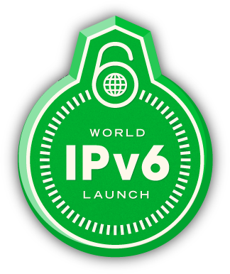

IPv6
OmaR AL-SaffaR

Slide 2
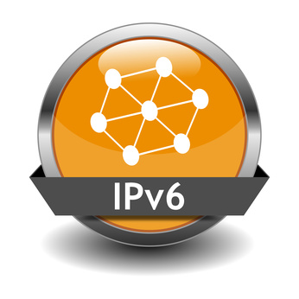
Over View
  Introduction to IPv6
  IPv4 and IPv6 Comparison
  Current issues in IPv4
  IPv6 solutions for IPv4 issues
  New issues of new protocol

Slide 3
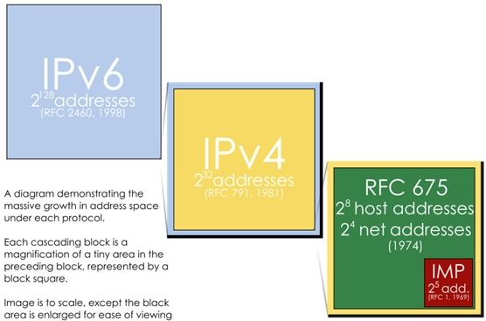
Development Stage of IP

Slide 4
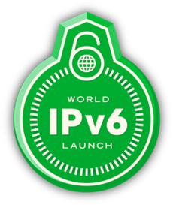
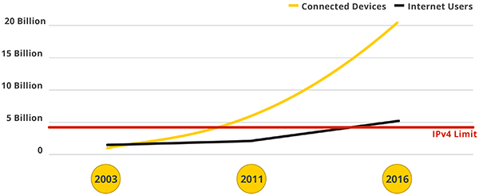
The Problem
The problem is that the current Internet addressing system, IPv4, only has room for about 4 billion addresses -- not nearly enough for the world's people, let alone the devices that are online today and those that will be in the future:
computers, phones, TVs, watches, fridges, cars, and so on. More than 4 billion devices already share addresses. As IPv4 runs out of free addresses, everyone will need to share.

Slide 5
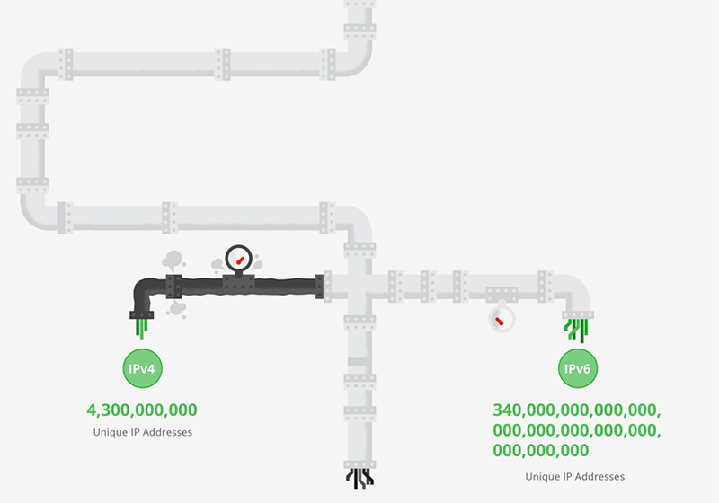
How are we making space to grow?
  Clearly the internet needs more IP addresses. How many more, exactly? Well, how about 340 trillion trillion trillion
  (or, 340,000,000,000,000,000,000,000,000,000,000,000,000)? That's how many addresses the internet's new "piping," IPv6, can handle. That's a number big enough to give everyone on Earth their own list of billions of IP addresses. Big enough, in other words, to offer the Internet virtually infinite room to grow, from now into the foreseeable future.

Slide 6
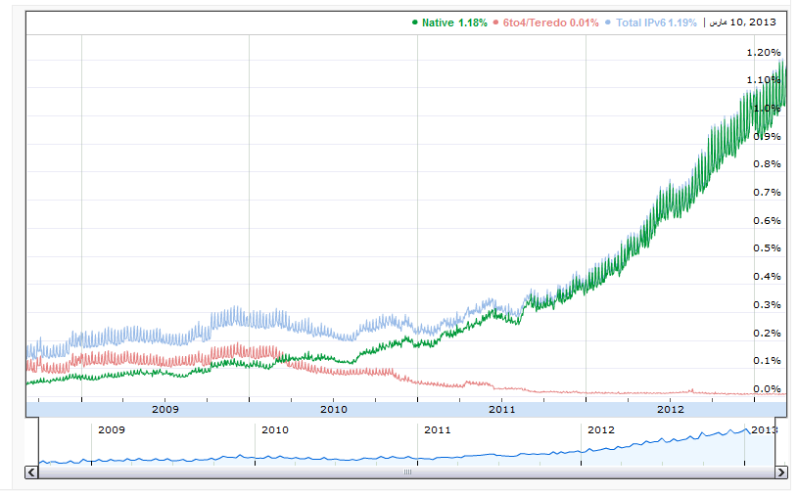
IPv6 Adoption
Measuring the availability of IPv6 connectivity among Google users. The graph shows the percentage of users that access Google over IPv6.

Slide 7
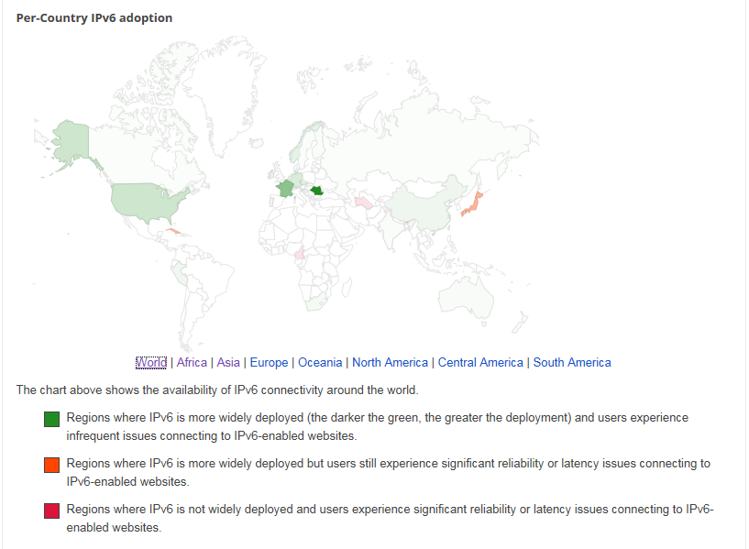

Slide 8
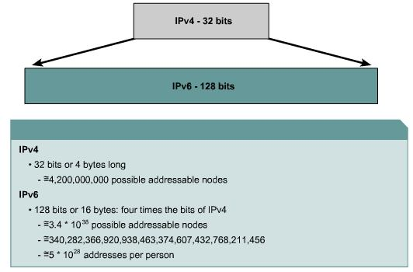
IPv4 and IPv6

Slide 9
When is the transition happening?
At Google was believed IPv6 is essential to the continued health and growth of the Internet and that by allowing all devices to talk to each other directly, IPv6 enables new innovative services. Replacing the Internet's plumbing will take some time, but the transition has begun. World IPv6 Launch on June 6, 2012, marks the start of a coordinated rollout by major websites and Internet service and equipment providers.
You do not need to do anything to prepare, but if you're interested in learning more and supporting IPv6.

Slide 10
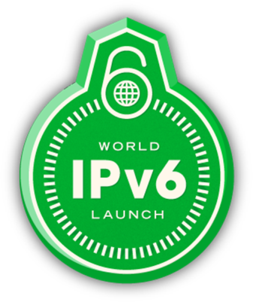
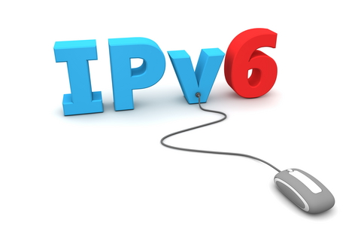
Introduction to IPv6
Why IPv6?
IPv6 Important features :
  Large address Space
  Simplified header
  Faster Packet Processing
  Enhanced QOS
  Improved Mobility and Security (Mobile IP, IPSec)
  Greater protocol Flexibility
  Dual-Stack approach (6to4 tunneling)
Notes:
The use of Sub netting and CIDR strategies have helped to slow down the process of running out of IP addresses, however with the continuing growth in the number of Internet hosts/users, the IP in its current version (IPV4) won’t be able to meet the high demands and interest in the Internet.
To remedy this weakness IETF defined a new version for IP (IPv6) with other additional advantages over IPv4.

Slide 11
The IPv4 Header
20 octets + options : 13 fields, including 3 flag bits
0
4
8
16
24
31
Ver
HL
Service Type
Total Length
Identifier
Flags
Fragment Offset
Time to Live
Protocol
Header Checksum
32 bit Source Address
32 bit Destination Address
Options and Padding
Shaded fields are absent from IPv6 header

Slide 12
The IPv6 Header
40 Octets, 8 fields
0
4
12
16
24
31
Version
Class
Flow Label
Payload Length
Next Header
Hop Limit
128 bit Source Address
128 bit Destination Address

Slide 13
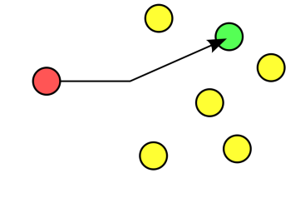
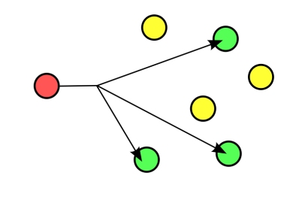
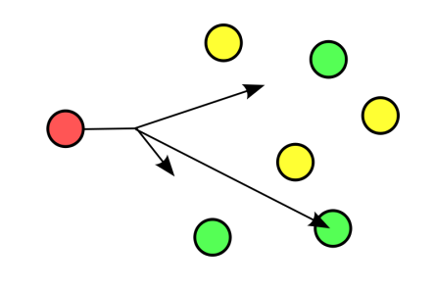
IPv6 Addressing
IPv6 Addressing rules are covered by multiples RFC’s
  Architecture defined by RFC 2373
Address Types are :
  Unicast : One to One
  Anycast : One to Nearest
  Multicast : One to Many
No Broadcast Address -> IPv6 Use Multicast
  One to One
One to Nearest
Anycast is similar to Multicast in that the destination is a group of address but instead of delivering the packet to each of them, it tries to deliver to just one of them. (Any member of the group possibly the closest).
Example of typical Anycast addressing will be a client wants to access information from Servers, “any” server will be fine. ….( Mobile IP)
One to Many
Notes:
No more Class A,B C and so on like IPv4
IPv6 defines 3 types of addressing: Unicast, Anycast, Multicast.
Unicast and Multicast are same as in IPv4
Anycast is similar to Multicast in that the destination is a group of address but instead of delivering the packet to each of them, it tries to deliver to just one of them. ( Any member of the group possibly the closest).
Example of typical Anycast addressing will be a client wants to access information from Servers, “any” server will be fine. ….( Mobile IP)

Slide 14
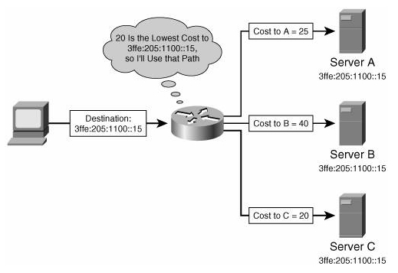
Anycast

Slide 15
Notation & Abbreviation
Notation
128 Bits = 16 bytes = 32 Hex digits
1111110111101100
1111111111111111
FDEC
:
BA98
:
7654
:
3210
:
ADBF
:
BBFF
:
2922
:
FFFF
Abbreviation
FDEC : BA98 : 0074 : 3210 : 000F : BBFF : 0000 : FFFF
Unabbreviated
Abbreviated
FDEC : BA98 : 74 : 3210 : F : BBFF : 0 : FFFF
Abbreviated
FDEC : 0 : 0 : 0 : 0 : BBFF : 0 : FFFF
Abbreviated
FDEC : 00 : BBFF : 0 : FFFF
More Abbreviated
FDEC :: BBFF : 0 : FFFF
Notes:
IPv6 addresses are represented as a series of 16-bit hexadecimal fields separated by colons (:).
The A, B, C, D, E, F in hexadecimal are case in-sensitive. In order to shorten the writing of IPv6 addresses, a few tricks are available.
The leading zeros in a field are optional, so that 0074= 74 and 0000 = 0.
Successive fields of 0 are represented as ::, but only once in an address.
An address parser is able to identify the number of missing zeros by putting the two parts apart and filling 0 until the 128 bits is complete. But if two:: are placed in the address, then there is no way to identify the size of each block of zeros. So only one:: is possible in a valid IPv6 address.
The use of the :: technique makes many addresses very small, for example, FDEC:0:0:0:0:0:1 becomes FDEC::1. The "unspecified" address is written as ::, since it contains all zeros.

Slide 16
IPv6 Addressing for IPv4
IPv4 - Compatible IPv6 Address format
96 Bits
32 Bits
0
IPv4 Address
0:0:0:0:0:0
192.168.10.10
IPv4 Compatible Address = 0:0:0:0:0:0:192.168.10.10
= ::192.168.10.10
IPv4 - Mapped IPv6 Address format
80 Bits
16 Bits
32 Bits
0
IPv4 Address
FFFF
0:0:0:0:0:0
192.168.10.10
IPv4-Mapped Address = 0:0:0:0:0:FFFF:192.168.10.10
Notes:
Address beginning with 80 zeros, are reserved for IPv4 addresses.
IPv6 supports two type of formats, distinguished by the next 16 bits:
Compatible: used when computers using IPv6 want to send/receive packets over IPv4 network.
Mapping : used when sender and networks use IPv6, but the receiver uses IPv4

Slide 17
IPv6 over IPv4 Tunnels
(6to4 tunneling)
IPv6 Header
Transport Header
Data
IPv6 HostA
Dual-Stack RouterA
Dual-Stack RouterB
IPv6 HostB
IPv6 Network
IPv4
IPv6 Network
Tunnel: IPv6 in IPv4 packet
IPv4 Header
IPv6 Header
Transport Header
Data
Tunneling is encapsulating the IPv6 packet in the IPv4 packet
Tunneling can be used by routers and hosts
Notes:
When tunneling IPv6 traffic over an IPv4 network, one edge router encapsulates the IPv6 packet inside an IPv4 packet and then the other router decapsulates it, and vice-versa. This enables the connection of IPv6 islands without the need to also convert the backbone to IPv6.

Slide 18
Dual Stack Approach & DNS
www.google.com
= * ?
IPv4
3ffe:b00::1
DNS Server
10.1.1.1
IPv6
3ffe:b00::1
In a dual stack case, an application that:
  Is IPv4 and IPv6-enabled
  Asks the DNS for all types of addresses
  Chooses one address, for example, connects to the IPv6 address
Notes:
The graphic shows the typical situation for dual-stack hosts with applications supporting both protocols.
An IPv6 and IPv4-enabled application send requests to the DNS for all types of addresses for the destination hostname (www.google.com).
The DNS server sends the answer back with all available addresses (IPv4 and IPv6) of the host.
The application chooses one or the other (the typical default is IPv6) and then requests the source host to connect to the destination host using IPv6.

Slide 19
References
http://www.ipv6.org
http://test-ipv6.com/
http://www.ipv6forum.com/
http://ipv6competition.com/index.html
http://www.google.com/intl/en/ipv6/
http://www.cisco.com/ipv6/
http://netscreen.com
http://www.sans.org
http://wikipedia.org

Slide 20




Questions?

