Slide 1

Web Cache
Directed by:
Eng. karam al-sofy

Slide 2
Introduction
what is web cache?
  Introducing proxy servers at certain points in the network that serve in caching Web documents for faster client access.
  Comparable to the cache memory in a computer system.
Why is it needed ?
  Rapid growth in HTTP traffic to form the largest part of the Internet traffic which causes more network congestion and server unavailability.
  The number of Web static pages almost doubles every year.

Slide 3
The Expected gains
Bandwidth saving
Improving content availability.
Improving web server availability.
Reducing network latency.
Server load balancing.
Improving user’s perception about network’s performance = Response Time.

Slide 4
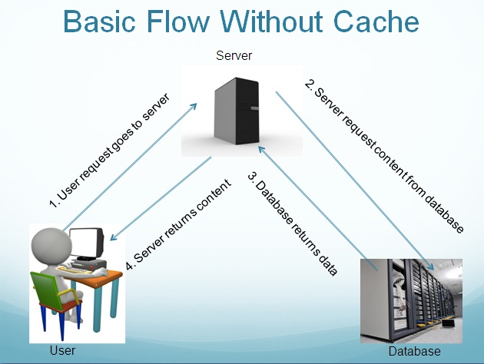
Basic Flow Without Cache

Slide 5
This Is Ok If…..
Not a lot of content
Small amount of users/page views
This Is Bad If…..
Lots of contents
Lots of users/page views

Slide 6
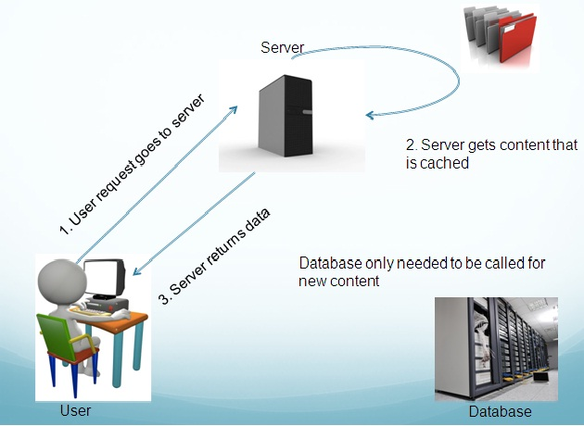
Flow With Cache

Slide 7
Classification of caches according to the location
Browser cache (User Agent Cache)
  Single user
Proxy Cache (Shared Cache)
  Multi-user
  (Surrogate Cache) Gateway Cache
  Multi-user

Slide 8
Browser Cache
Implemented on a single user’s machine.
Local hard drive space stores representation of viewed content.
Simple rules for control.
Usefulness
  Recently viewed pages (Back/Forward button)
  Commonly used images

Slide 9
Proxy Cache
Similar concept, but for multiple users.
Usually implemented on a firewall or separate device known as intermediaries.
Request routing can be manually or through an interception proxy.
Usefulness
  Latency and network traffic are reduced

Slide 10
Gateway Cache
Also known as reverse proxy caches.
Implemented on separate devices by a website administrator.
Distributed gateway caches are used in Content Delivery Networks (CDN).
Usefulness
  Increased scalability, reliability, and performance

Slide 11
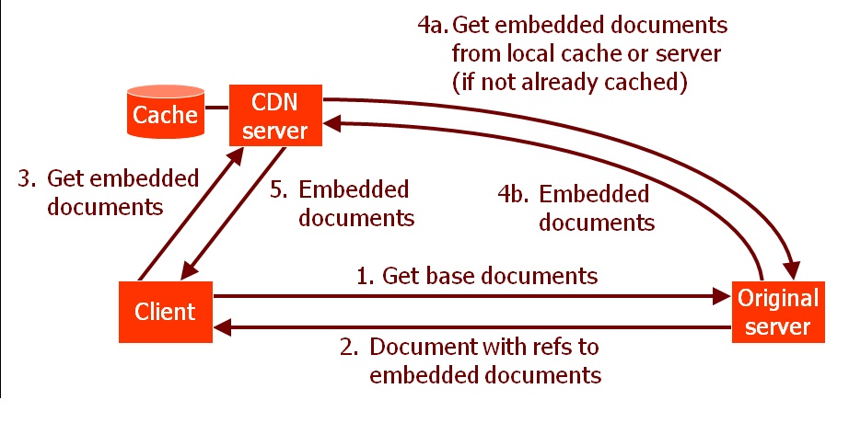
Content Delivery Network (CDN)

Slide 12
Types of Caches
Simple Proxy (Normal/Regular)
Transparent Proxy
Reverse Proxy
Adaptive Caching
Push Caching
Active Caching
Streaming Caches

Slide 13
Normal (regular cache)proxy
A regular caching proxy server is a server which listens on a separate port (e.g. 3128) and the clients (browsers) are configured to send requests for connectivity to that port. So the proxy server receives the request, fetches the content and stores a copy for future use. So next time when another client requests for the same webpage the proxy server just replies to the request with the content in its cache thus improving the overall request-reply speed.

Slide 14
Transparent Proxy
A transparent proxy server is also a caching server but the server is configured in such a way that it eliminates the client side (browser side) configuration. Typically the proxy server resides on the gateway and intercepts the WWW requests (port 80, 443 etc.) from the clients and fetches the content for the first time and subsequently replies from its local cache. The name Transparent is due to the fact that the client doesn't know that there is a proxy server which mediates their requests. Transparent proxy servers are mostly used in big corporate organizations where the client side configuration is not easy (due to the number of clients).
This type of server is also used in ISP's to reduce the load on the bandwidth usage.

Slide 15
Advantage & Disadvantage of use transparent proxy
No client configuration.
Violates end-to-end paradigm
  Client thinks it is talking directly to server
  Server thinks it is talking to cache
Implemented as
  Pass-through unit
  L4 switch

Slide 16
Advantage & Disadvantage (continued…)
  Only port 80
  FTP not supported
  To be efficient modern browsers are required
  No user control. Users can’t bypass the cache
  Stability / Reliability

Slide 17
Reverse Proxy:
A reverse proxy is totally different in its usage because it is used for the benefit of the web server rather than its clients. Basically a reverse proxy is on the web server end which will cache all the static answers from the web server and reply to the clients from its cache to reduce the load on the web server.
This type of setup is also known as Web Server Acceleration.

Slide 18
Adaptive Web Caching
  - Uses distributed cache meshes to solve the hot spot problem
  Caches dynamically join and leave the groups based on content demand
  Administrative boundaries must be relaxed
Push Caching
  Keep data close to those clients requesting this information
  Assumption: we are able launch caches that may cross administrative boundaries
  Incurs cost (storage and transmission)

Slide 19
Active Caching
  Applies caching to dynamic documents
  30 % of client HTTP requests contains cookies
  The servers provides the cache with the objects and any associated cache applets

Slide 20
Higher Level Caching
SQUID
Squid is a free, open source(based on Lunix) , proxy caching server for web clients.
It operates as an intermediary between the web browsers (clients) and the server they access.
Technically, A proxy server can simply to manage traffic between a web server and the clients that want to communicate with it, without doing caching at all. Squid combine both capabilities as a server.

Slide 21
SQUID (continued…)
It supports transparent proxying.
It works on port no. 3128.
Extensive access controls and great server accelerator.
It support following protocols (HTTP,HTTPS,DNS,FTP,SSL,ICP,HTCP,SNMP)
Three main components (client side, server side, storage manager)

Slide 22
Architecture of Squid

Slide 23
2. Varnish: it is a program that is designed to act as a proxy server (reverse) and high-performance storage, a HTTP accelerator.
3. XtraDB: If you are using a My SQL database, this caching solution can help optimize performance of your database better than the standard InnoDB

Slide 24
Hierarchical Caching
Caches are arranged in a tree-like structure
A child cache can query parent caches and other siblings
A parent cache can never query children
This maintains information gradually filtering down to the leaves
To avoid swamping parents with information, clustering may be applied to hierarchies.

Slide 25
Cache control
HTTP defines three basic mechanisms for controlling caches: freshness, validation, and invalidation
Freshness allows a response to be used without re-checking it on the origin server, and can be controlled by both the server and the client. For example, the Expires response header gives a date when the document becomes stale, and the Cache-Control: max-age directive tells the cache how many seconds the response is fresh for.

Slide 26
Validation can be used to check whether a cached response is still good after it becomes stale. For example, if the response has a Last-Modified header, a cache can make a conditional request using the If-Modified-Since header to see if it has changed. The ETag (entity tag) mechanism also allows for both strong and weak validation.
Invalidation is usually a side effect of another request that passes through the cache. For example, if a URL associated with a cached response subsequently gets a POST, PUT or DELETE request, the cached response will be invalidated.

Slide 27
Thank you for listening

